Slide 1
JavaScript Course

Slide 2
How Website Works?

Slide 3


Client VS Server
User Send Request
User Get Response
WEBSITE
HTML
CSS
JS

Slide 4

Building Block of Website
HTML
JS
Provides the structure and content of a webpage
Adds interactivity and dynamic behavior to the webpage
CSS
Style and design the appearance of the webpage

Slide 5
What is JavaScript ?
JavaScript improves the user experience of the web page by converting it from a static page into an interactive one.
JavaScript is used to update and change both HTML, CSS.
It adds behavior to web pages.

Slide 6
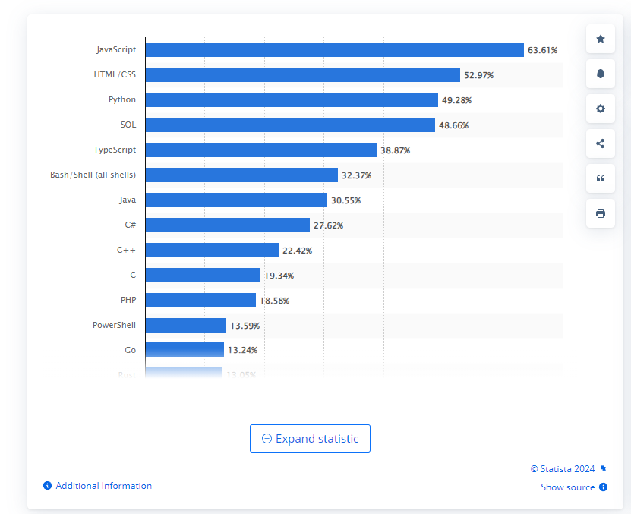
Why JavaScript?
Most used programming language among developer’s worldwide as of 2023.

Slide 7


History of JavaScript
In 1995 – Created by Brendan Eich at Netscape in just 10 days.
Switching from LiveScript to JavaScript was a smart move to make it sound cooler and piggyback on Java’s fame, while also cozying up to Sum Microsystems.
Mocha
LiveScript
JavaScript
1996
1997
2015
JavaScript
ECMA International
ES6 / ECMAScript 2015
It was then submitted to ECMA International for standardization, which resulted in ECMAScript
JavaScript was Created
Decide to switch to annual releases of ECMAScript.

Slide 8
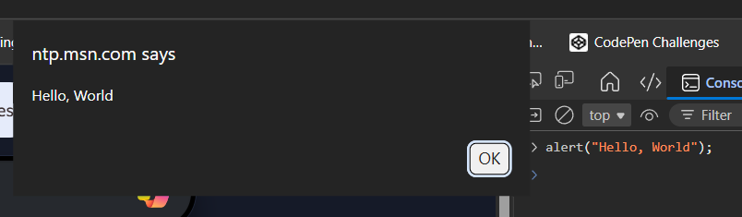
Our First JavaScript code in Console

Slide 9
Ways to Write JavaScript

Slide 10
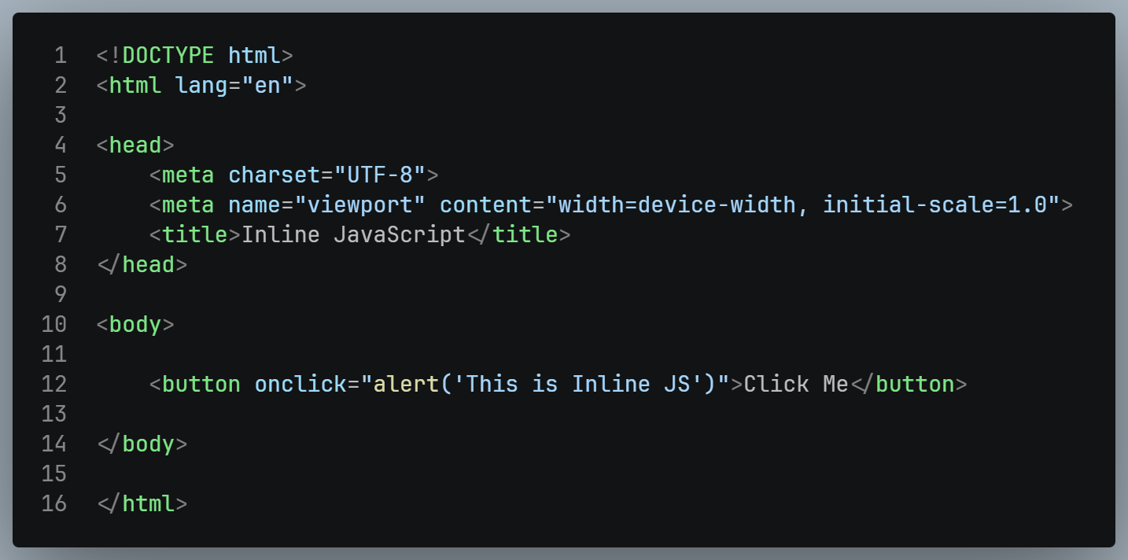
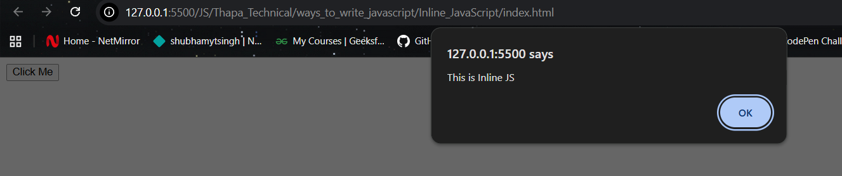
Inline JavaScript

Slide 11
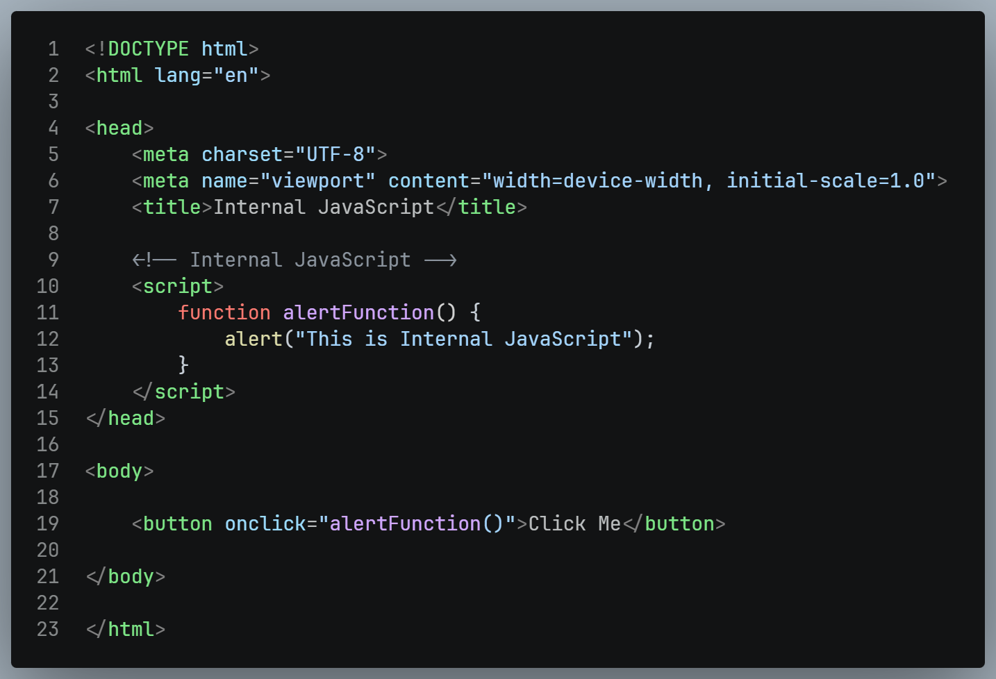
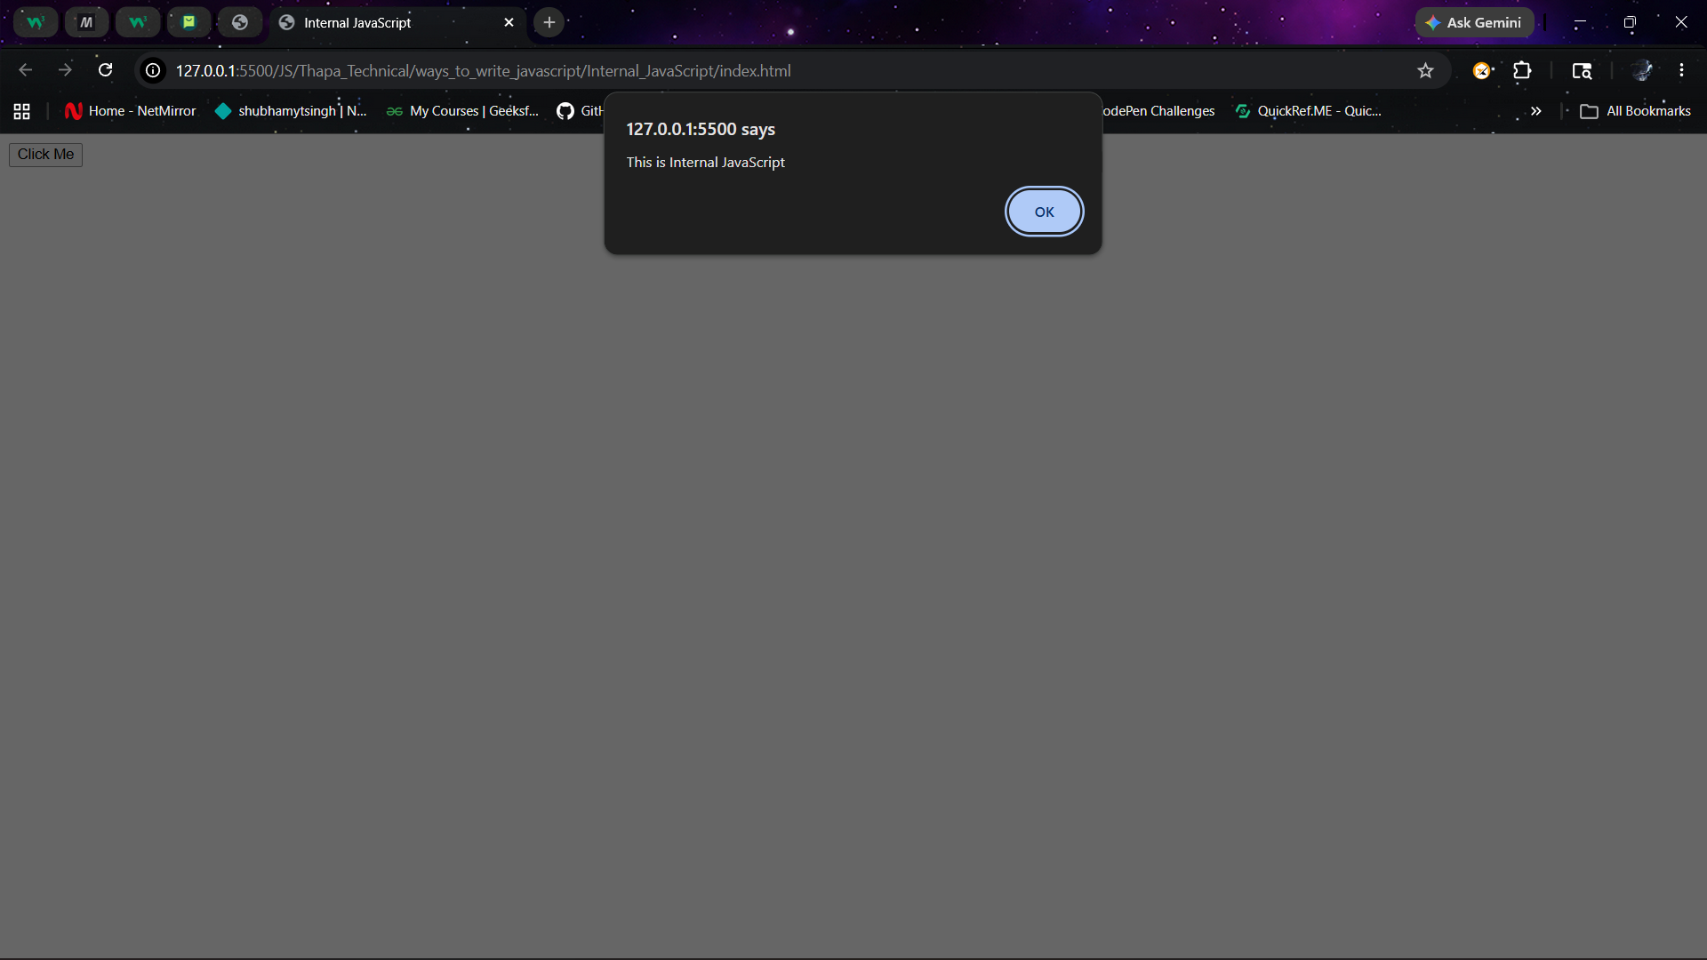
Internal JavaScript

Slide 12
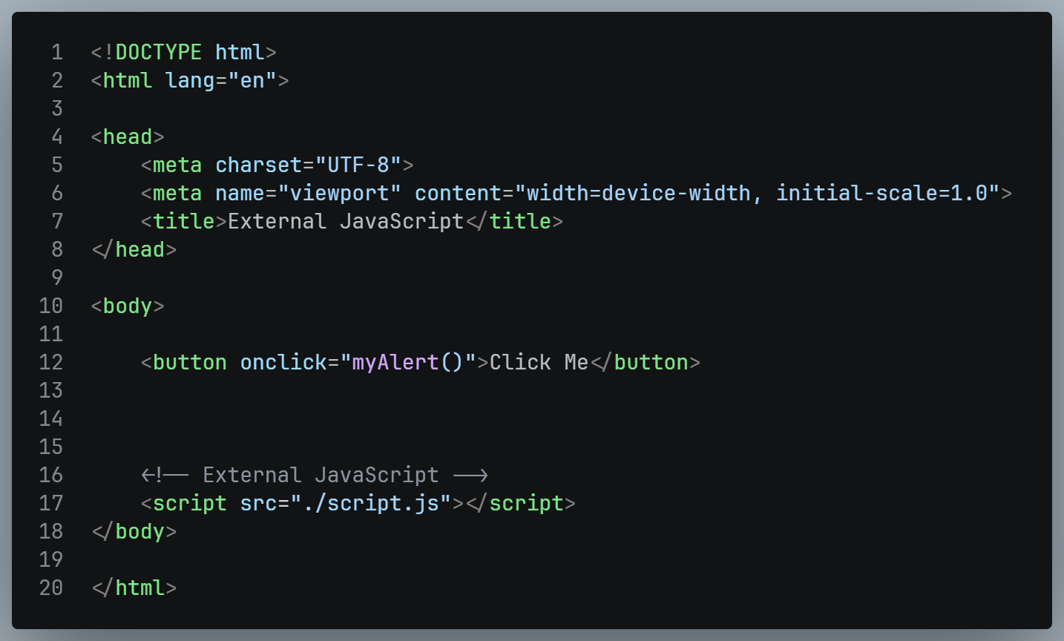

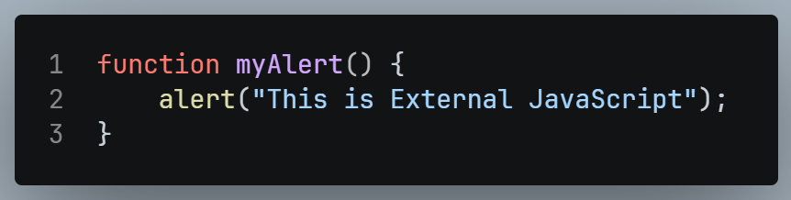
External JavaScript

Slide 13
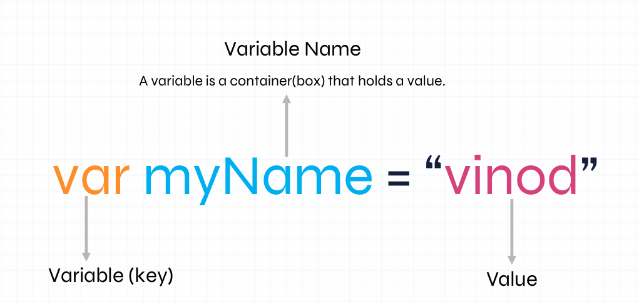
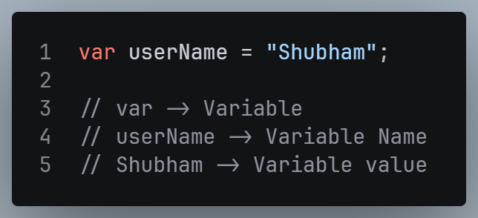
Values & Variables
In JavaScript, values & variables are fundamental concepts that form the basic of programming.
Values: A value is a piece of information that a program can work with. It can be number, text, true/false, or more complex data.
Variables: A variable is a container that holds a value. It has a name and can be used to store a manipulate data in a program.

Slide 14
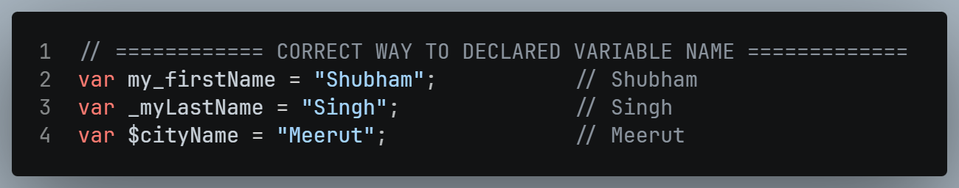
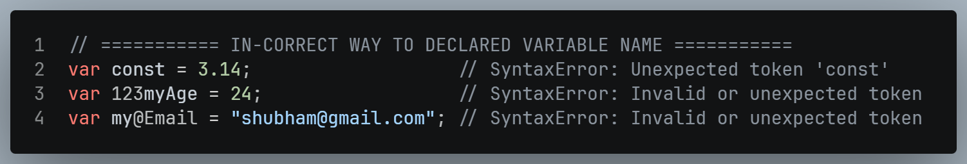
Naming Variables: Rules & Best Practice
Variable names must start with a letter, an underscore(_) or a dollar sign ($).
Variables names cannot contain spaces.
By convention, JavaScript variable names are written in camelCase.
Variables cannot be the same as reserved keywords such as if or const.
Variable names are case-sensitive.
Variable names can be as long as we need.

Slide 15
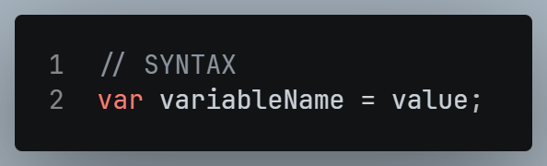
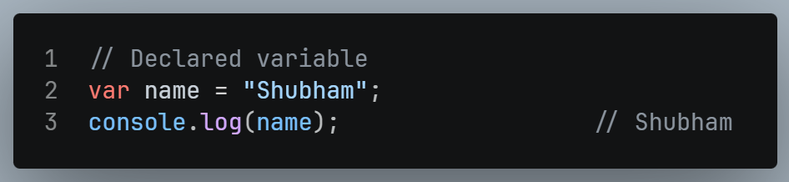
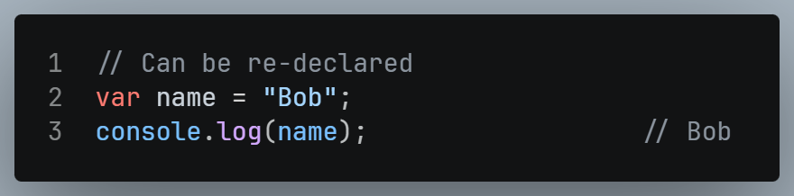
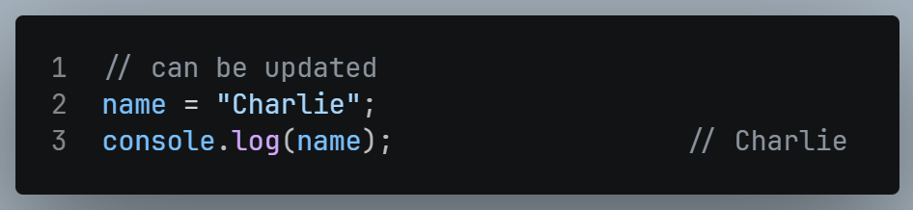
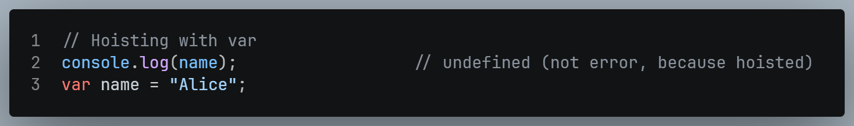
var
The oldest way to declare a variable in JavaScript.
It is function scoped and hoisted.

Slide 16



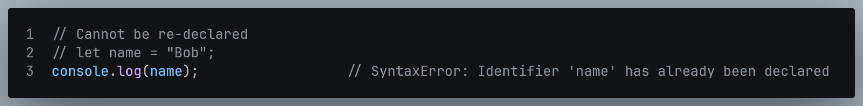
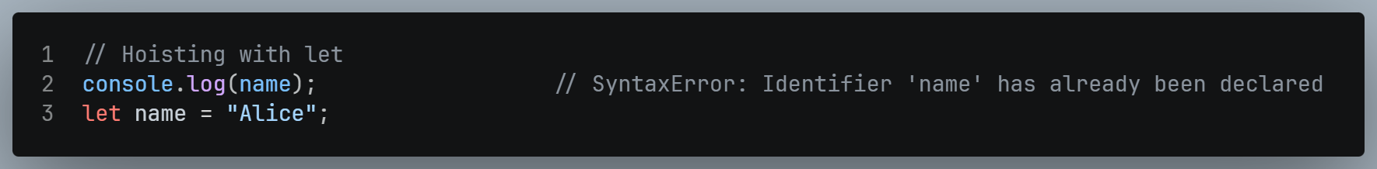
let
Introduced in ES6.
It is block scoped and not hoisted like var.

Slide 17
Key Difference (var, let, const)
Variable | Re-declared | Re-Assign | Hoisted | Scope | When to use
var | Yes ✅ | Yes ✅ | Yes ✅ | Function | Old way
let | No ❌ | Yes ✅ | No ❌ | Block | Use when value changes
const | No ❌ | No ❌ | No ❌ | Block | Use when Value never changes

Slide 18
Data Types
Data Types
Primitive Datatypes
Non-Primitive Datatypes (Reference Datatypes)
Number
null
Boolean
BigInt
String
Symbol
Undefined
Arrays
Object
Function
Data type define the type of value that a variable can hold.
There are 2 types of Data types:
Primitive Datatypes
Number
null
Boolean
BigInt
String
Symbol
Undefined
Non-Primitive Datatypes (Reference Datatypes)
Array
Object
Function

Slide 19
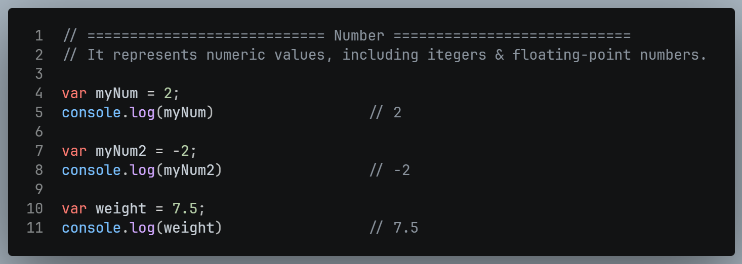
Primitive Datatype (Number)

Slide 20
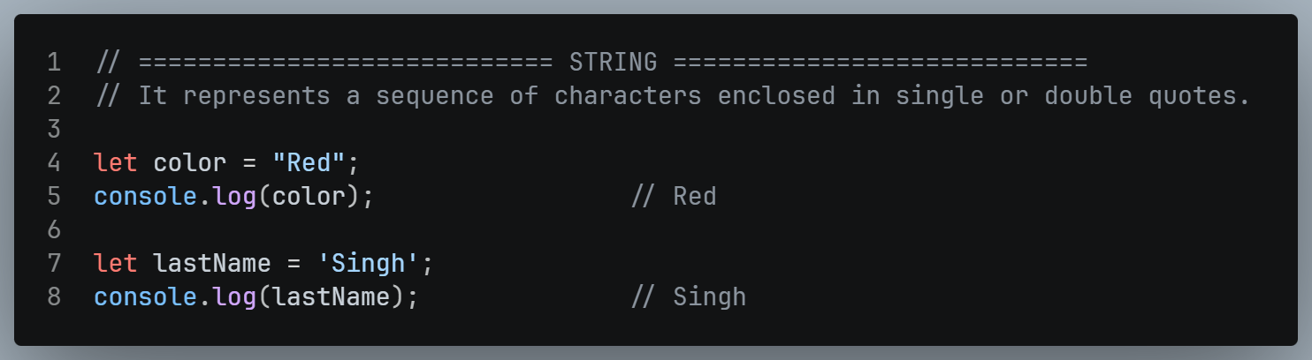
Primitive Datatype (String)

Slide 21
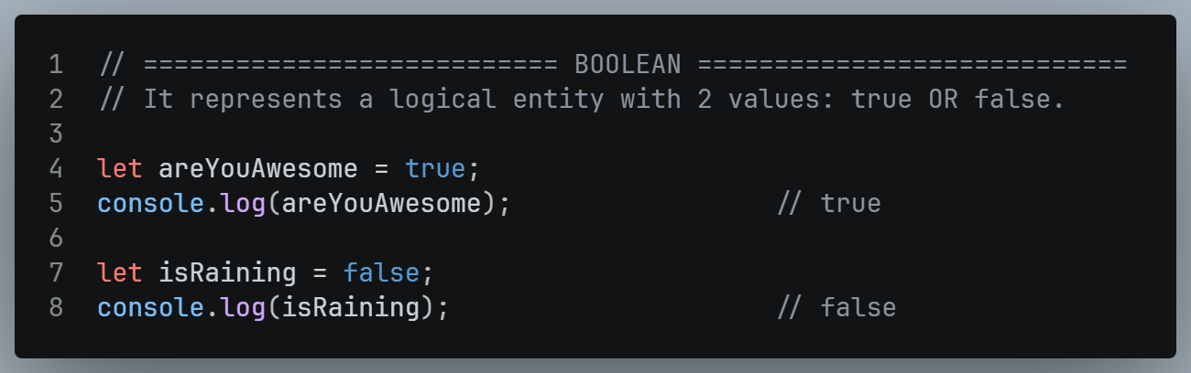
Primitive Datatype (Boolean)

Slide 22
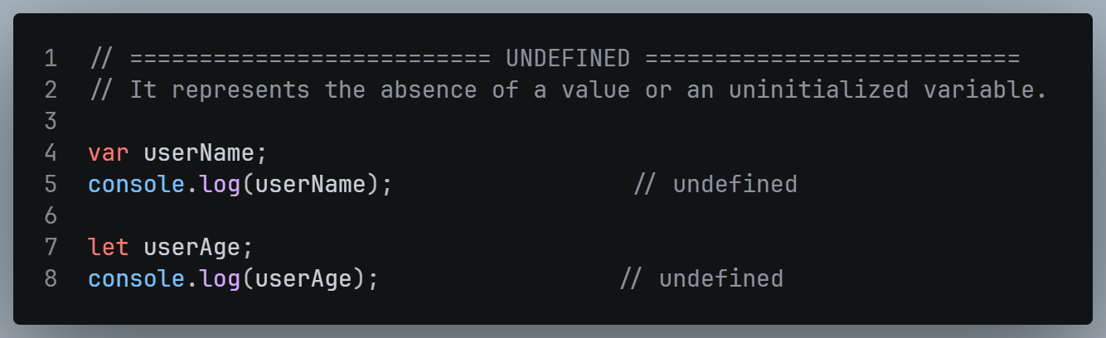
Primitive Datatype (Undefined)

Slide 23
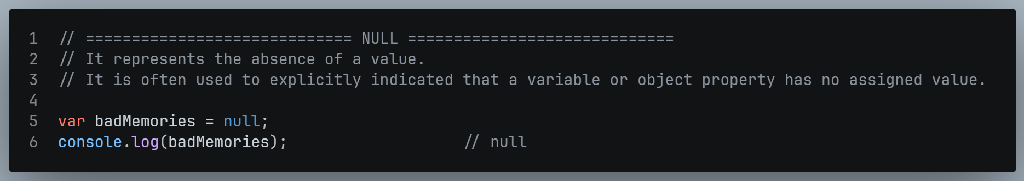
Primitive Datatype (null)

Slide 24
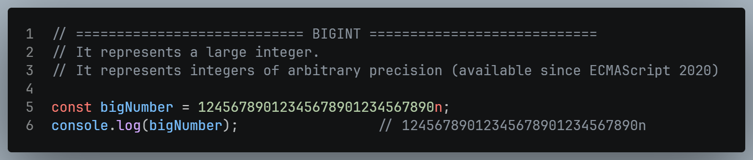
Primitive Datatype (BigInt)

Slide 25
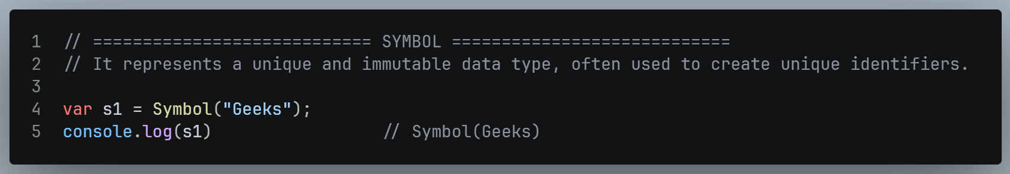
Primitive Datatype (Symbol)

Slide 26
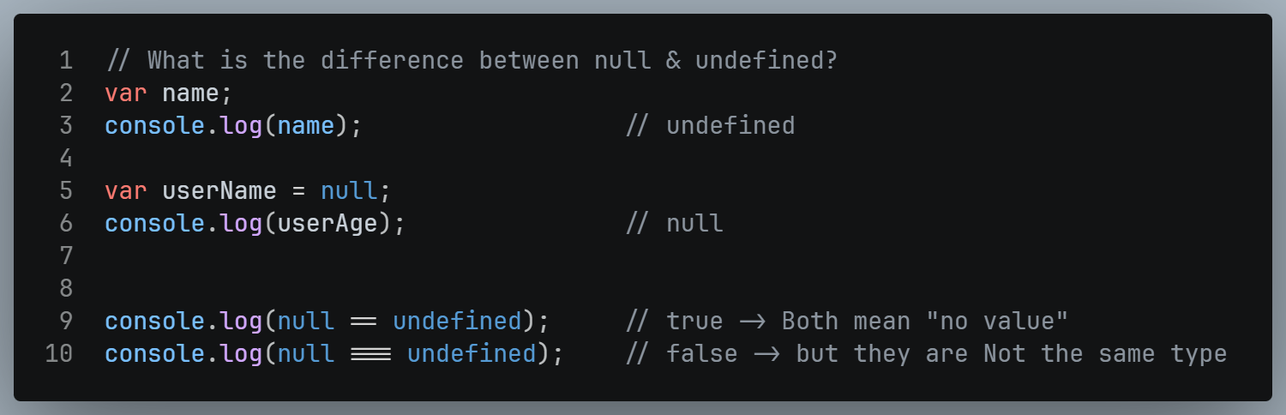
Interview Questions – Data Types What is the difference between null & undefined?
Undefined
When we create a variable but don't give it a value, JavaScript automatically sets it to undefined. It basically means "this exists, but has no value yet".
Null
null is something we set yourself. It means "this variable is empty on purpose".

Slide 27
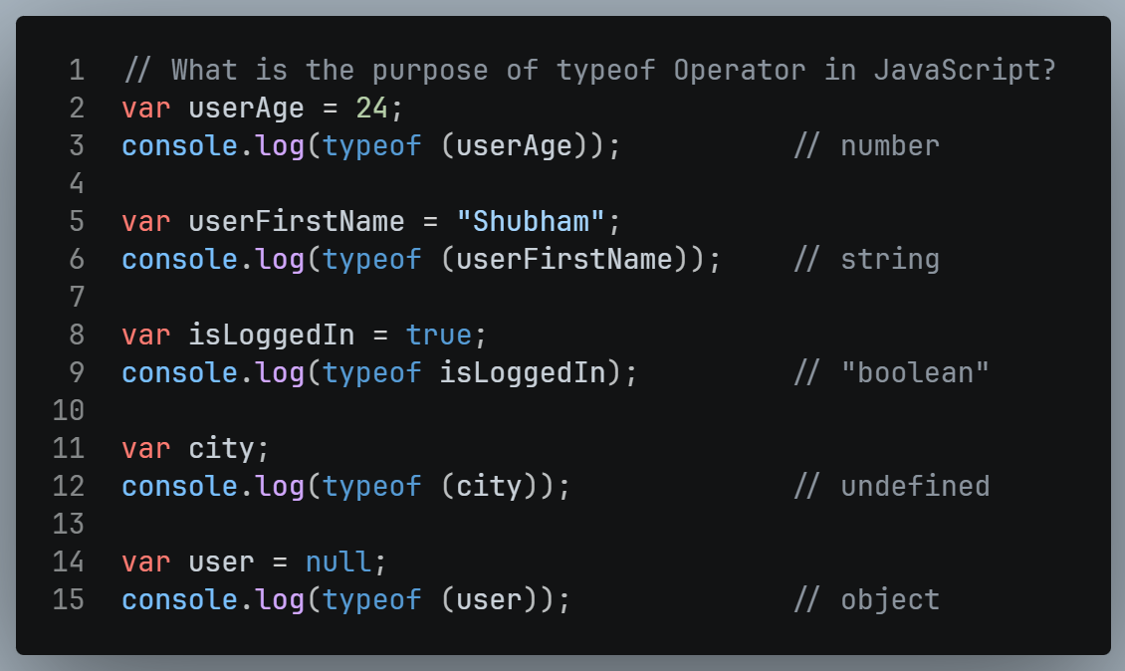
Interview Questions – Data Types What is the purpose of typeof operator in JavaScript?
typeof is an operator that tells you what type of value is stored in a variable. It always returns the answer as a string.

Slide 28
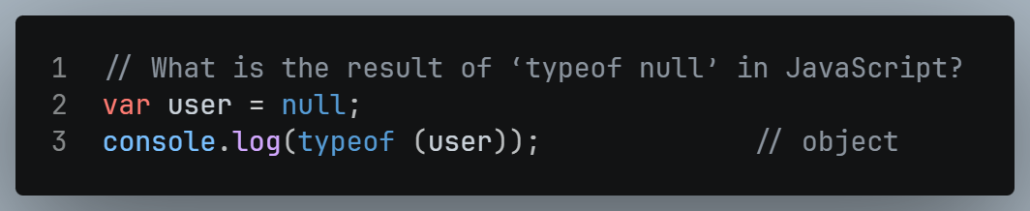
Interview Questions – Data Types What is the result of ‘typeof null’ in JavaScript?
typeof null → "object"?
This is a known bug in JavaScript from the very beginning. It was never fixed because fixing it would break old websites. Just remember it as a special case.

Slide 29
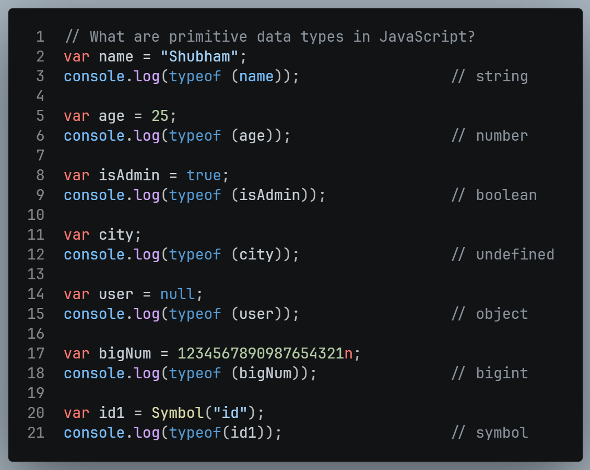
Interview Questions – Data Types What are primitive data types in JavaScript?
A primitive is the simplest form of data. It stores only one single value and has no methods or properties of its own.

Slide 30
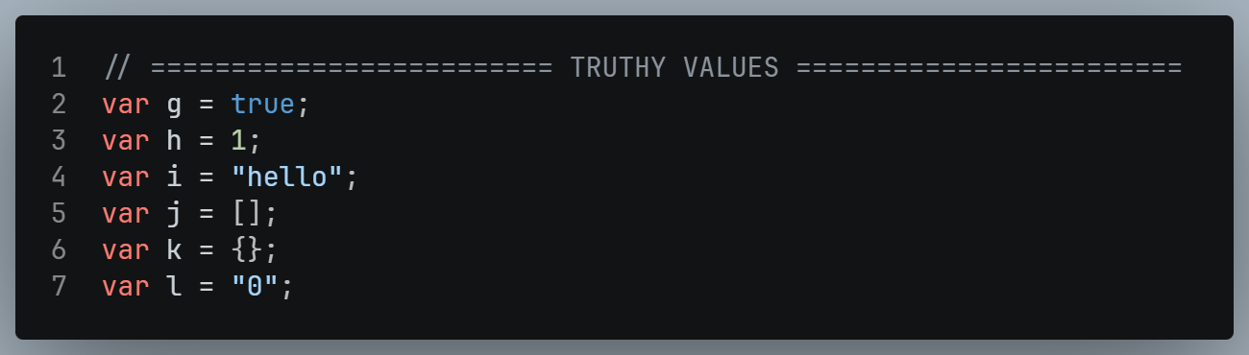
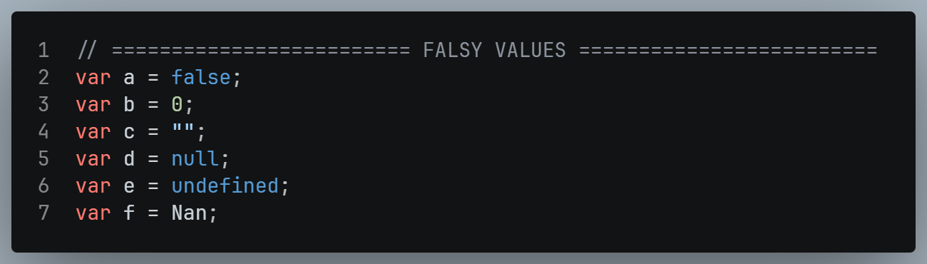
Interview Questions – Data Types Explain the concept of truthy & falsy values in JS with examples?
In JavaScript, every value is either truthy or falsy.
This means when JavaScript needs a true/false decision, it automatically converts any value into true or false.

Slide 31
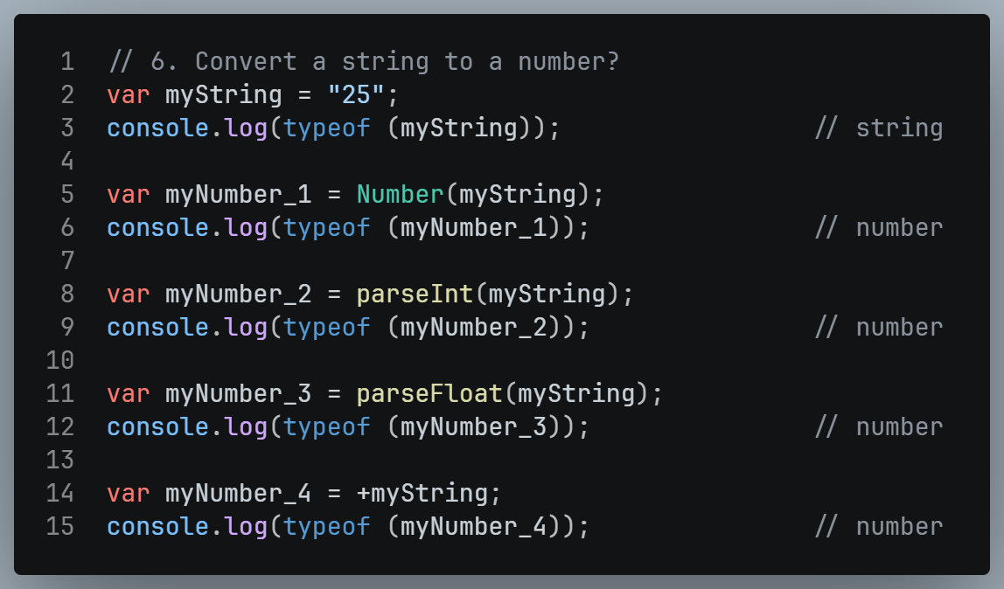
Interview Questions – Data Types Convert a string into number?
We have different ways to convert String to a Number.

Slide 32
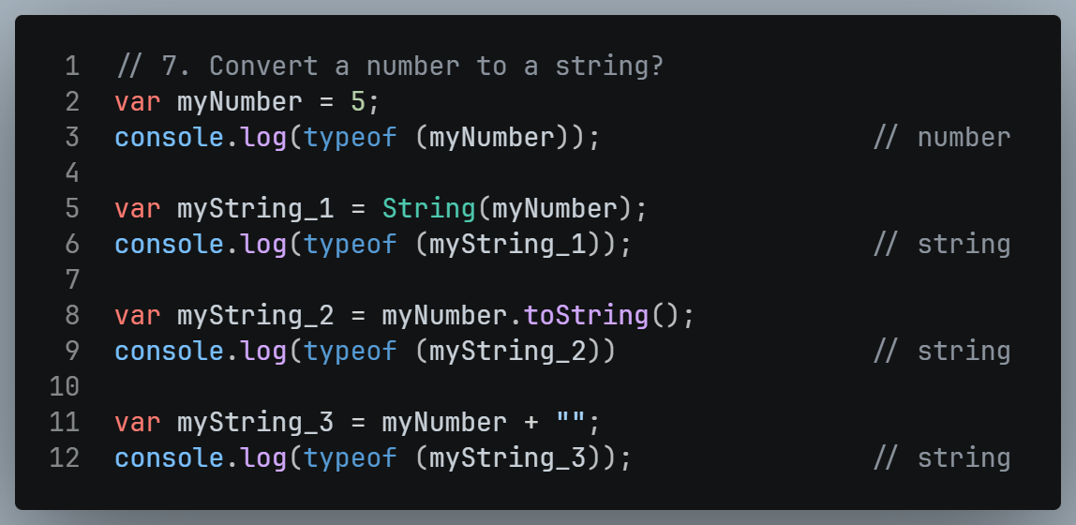
Interview Questions – Data Types Convert a number into string?
We have 3 ways to convert number into string:

Slide 33
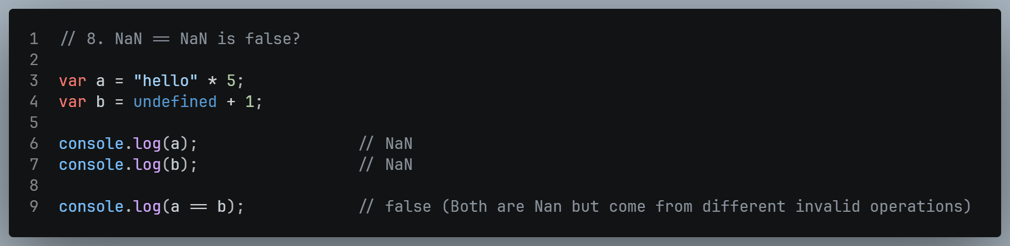
Interview Questions – Data Types NaN == NaN is false ?
NaN means "Not a Number". It appears when you try to do an invalid math operation.
Because NaN means "some invalid number" — and two invalid results can come from completely different operations. So JavaScript says they are never equal.

Slide 34
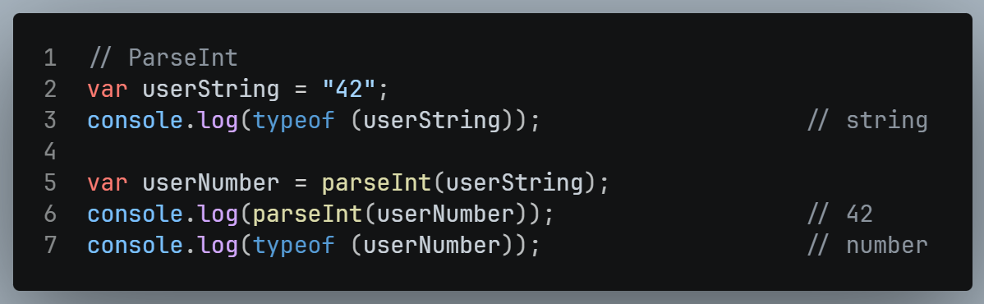
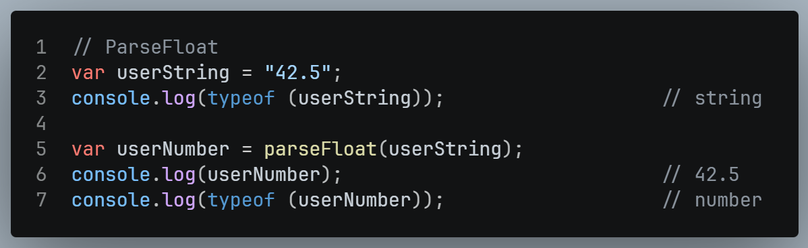
ParseInt & ParseFloat (parseInt and parseFloat are both functions in JavaScript used for converting strings to numbers, but they have different use cases.)
ParseInt
parseInt is used to parse a string and convert it to an integer (whole number).
parseInt is used for converting to integers and ignores anything after the decimal point.
ParseFloat
parseFloat is used to parse a string and convert it to a floating-point number (decimal number).
parseFloat is used for converting to floating-point numbers, preserving the decimal part.

Slide 35
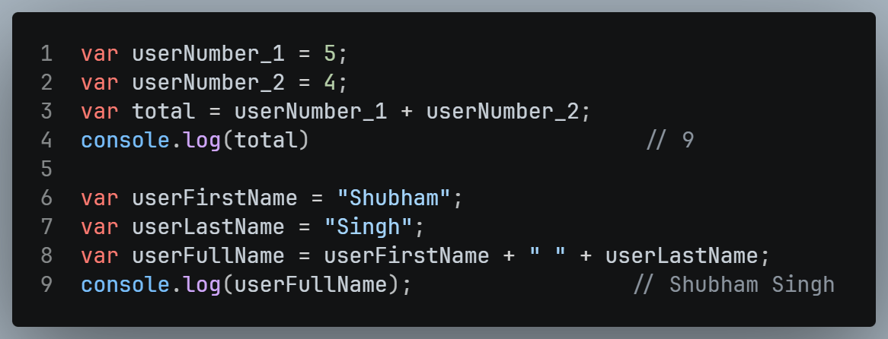
Concatenation
In JavaScript, the + sign is not only used for arithmetic addition but also for string concatenation. When the + operator is used with strings, it concatenates the strings together.
It's important to note that if any operand of the + operator is a string, JavaScript will treat the other operands as strings as well, resulting in string concatenation. If both operands are numbers, the + operator performs numeric addition.

Slide 36
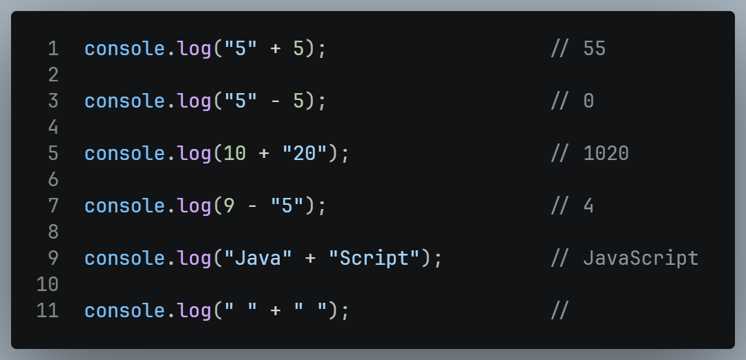
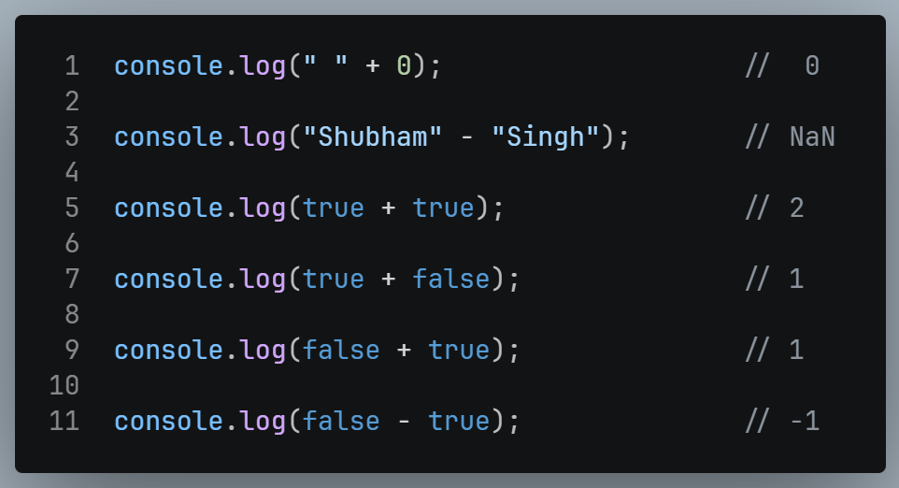
Type Coercion
Type coercion is the automatic conversion of "values" from one data type to another.
It is a fundamental part of JavaScript and can be used to make code more readable and efficient.
There are two types of coercion in JavaScript:
Implicit coercion happens automatically.
Explicit coercion is done manually by the programmer.

Slide 37
Expressions & Operators
OPERATOR
5 + 75
EXPRESSION
OPERANDS

Slide 38
Control Statements & Loops
if…else Statement
Switch Statement
While Loop
Do While Loop
For Loop
For-in / for-of Loop

Slide 39

Types of Operators
Types of Operators
Assignment Operators
Comparison Operators
Ternary (Conditional) Operators
Type Operators
Unary Operators
Arithmetic Operators
Logical Operators
String Operators

Slide 40
Operators (Assignment Operators)
Assignment operators in programming are symbols used to assign values to variables.
They take the value on the right side of the operator and assign it to the variable on the left side.
Let x = 10, y = 5
Operator | Example | Same As | Result
= | x = y | x = y | x = 5
+= | x += y | x = x + y | x = 15
-= | x -= y | x = x – y | x = 5
*= | x *= y | x = x * y | x = 50
**= | x **= y | x = x ** y | x = 100000
%= | x %= y | x = x % y | x = 0
/= | x /= y | x = x / y | x = 2

Slide 41
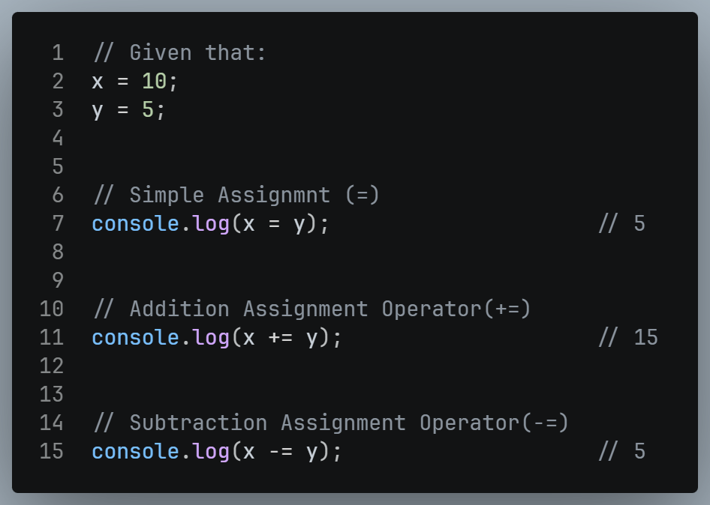
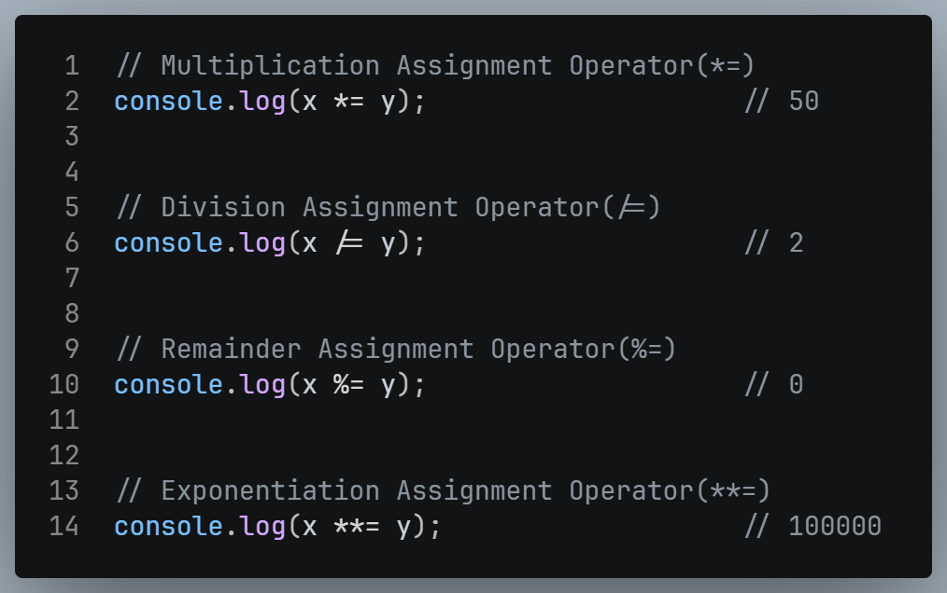
Operators (Assignment Operators)

Slide 42
Operators (Arithmetic Operators)
Arithmetic operators in programming perform basic mathematical operations on variables or values.
They include addition, subtraction, multiplication, division, and modulus.
Operator | Operator Name
+ | Addition
- | Subtraction
* | Multiplication
** | Exponential
/ | Division
% | Modulus (Remainder)
++ | Increment
-- | Decrement

Slide 43
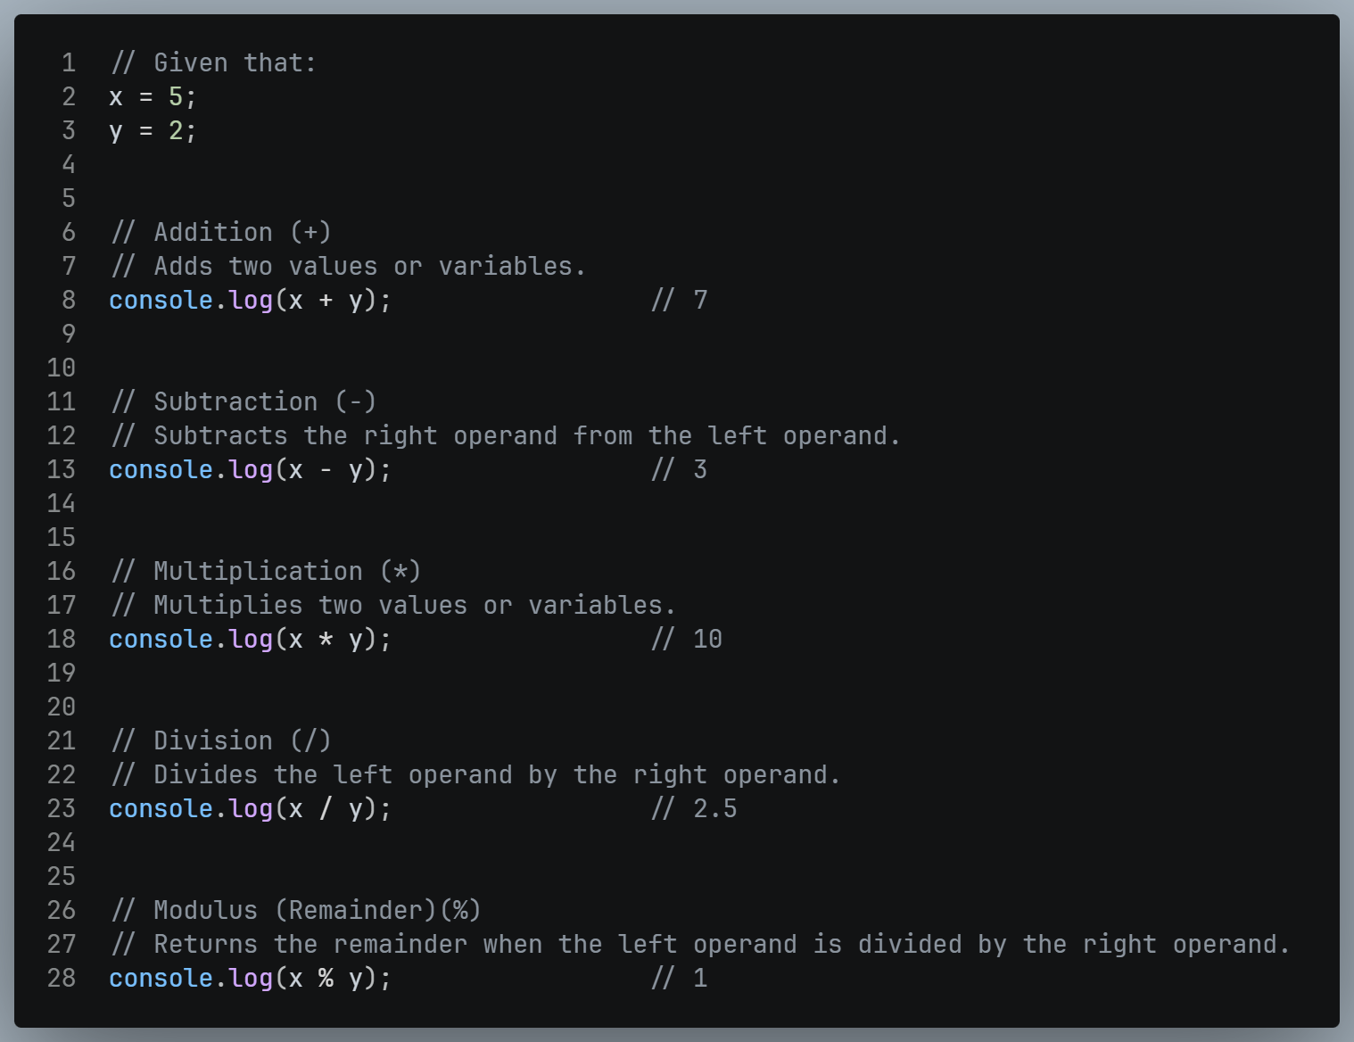
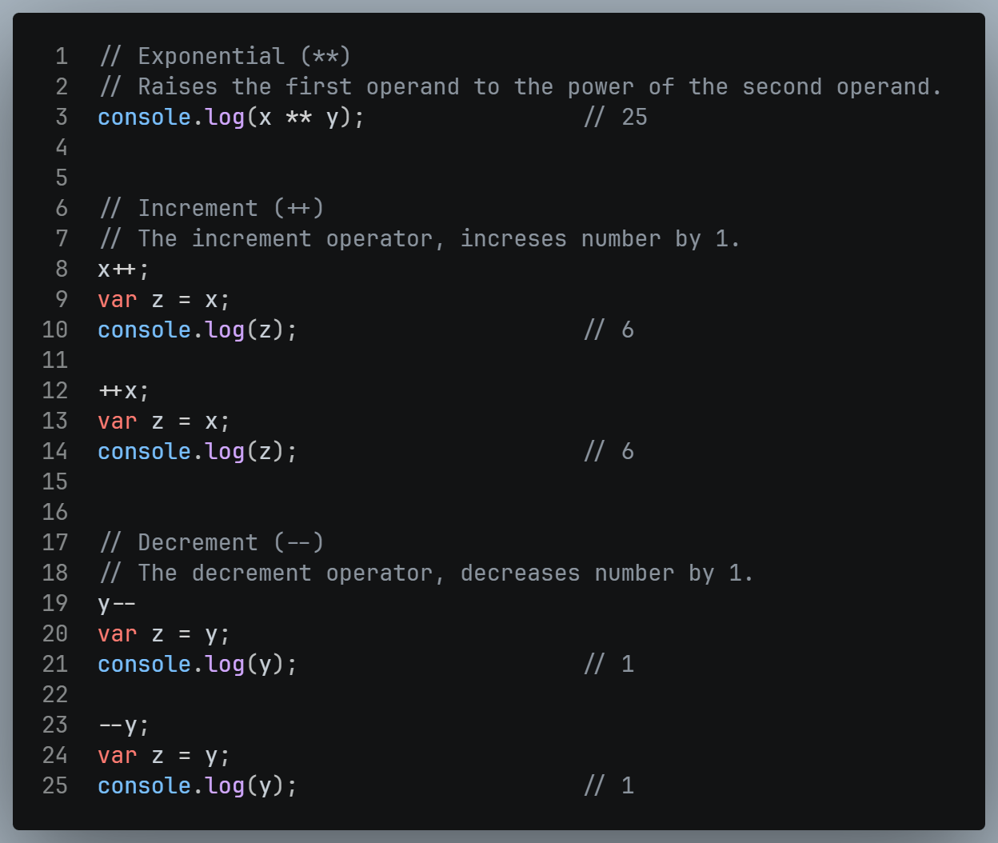
Operators (Arithmetic Operators)

Slide 44
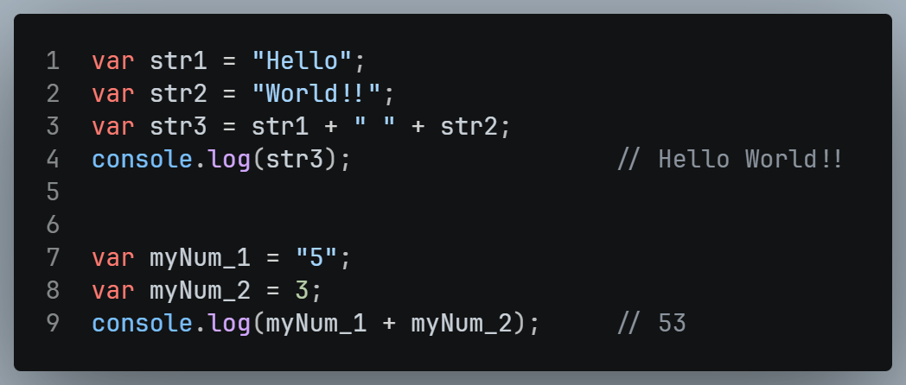
Operators (String Operators)
There are a few ways to concatenate strings in JavaScript.
The most common way is to use the + operator.
For example, to concatenate the strings "Hello" and "World", you would use the following code:

Slide 45
Operators (Comparison Operators)
Operator | Description
== | Equal to
=== | Strict Equal to
!= | Not equal to
!== | Strictly not equal to
> | Greater than
< | Less than
>= | Greater than or equal to
<= | Less than or equal to
Comparison operators in JavaScript are used to compare values and return a Boolean result (true or false).

Slide 46
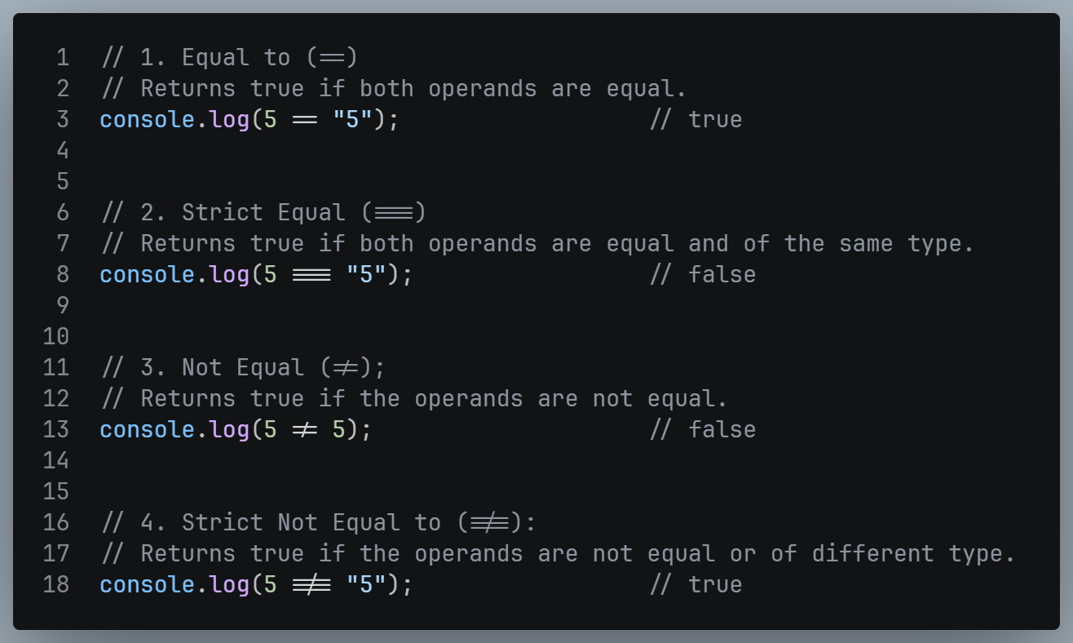
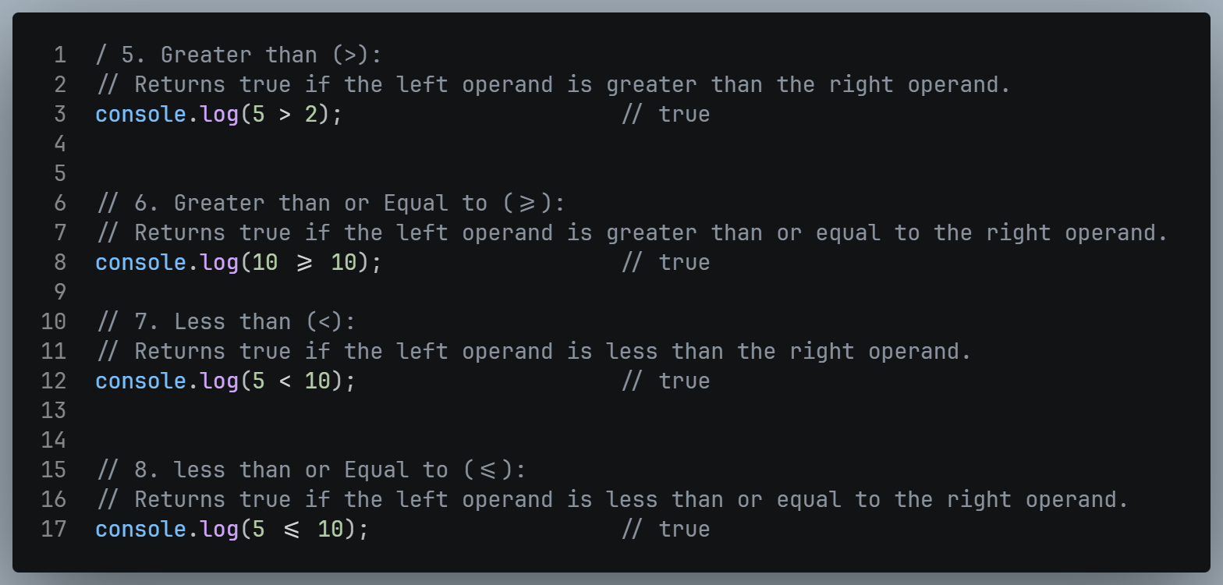
Operators (Comparison Operators)

Slide 47
Operators (Logical Operators)
Logical operators are used to combine boolean expressions.
Logical operators can be used to modify the results of comparisons.
Typically, you will use a comparison operator to check a condition, and a logical operator to combine conditions into more complex logic.
Operator | Name
&& | AND
|| | OR
! | NOT

Slide 48
Operators (Logical Operators Table)
Logical AND Operator
X | Y | RESULT
true | true | true
true | false | false
false | true | false
false | false | false
Logical OR Operator
X | Y | RESULT
true | true | true
true | false | true
false | true | true
false | false | false
Logical NOT Operator
X | RESULT
true | false
false | true

Slide 49
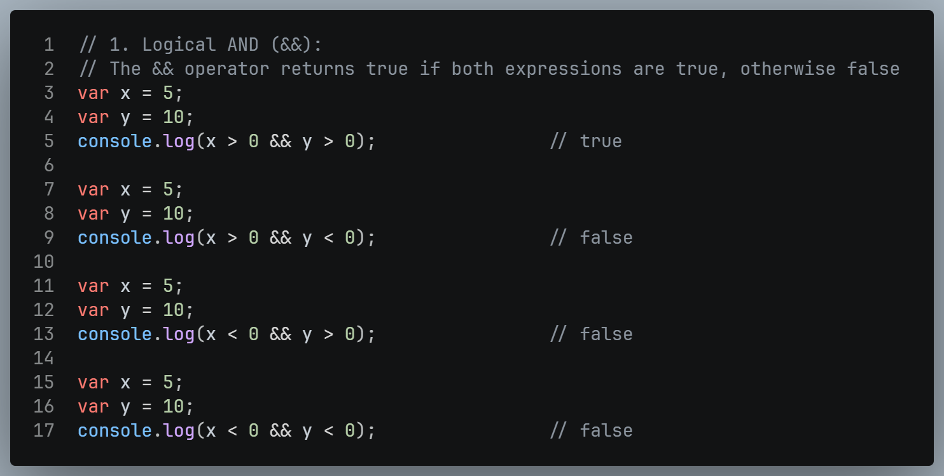
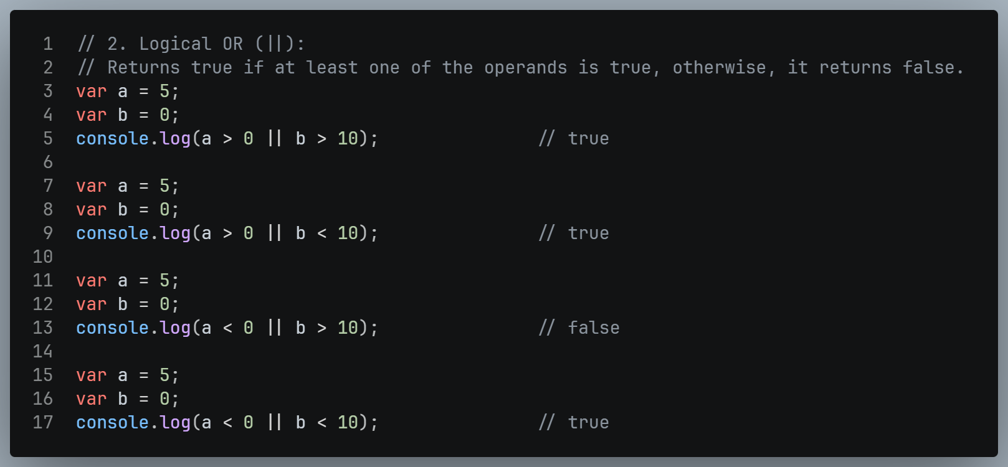
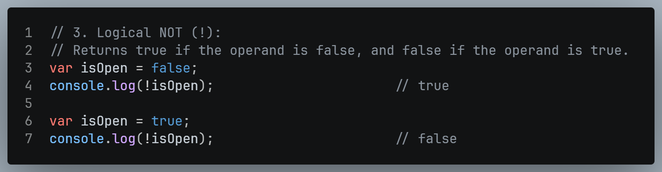
Operators (Logical Operators )

Slide 50
Operators (Unary Operators)
Operator | Name | Description
+x | Unary Plus | Convert a value into a number
-x | Unary Minus | Convert a value into a number and negate it
++x | Increment Operator (Prefix) | Adds 1 first, then uses value
--x | Decrement Operator (Prefix) | Subtract 1 first, then uses value
x++ | Increment Operator (Postfix) | Uses value first, then adds 1
x-- | Decrement Operator (Postfix) | Use value first, then subtract 1
Unary operators in JavaScript are operators that work with only one operand.
They perform various operations such as negation, incrementing, decrementing, type conversion, and more.

Slide 51



Operators (Unary Operators)

Slide 52
Operators (Ternary Operators)
Parameter | Name
Condition | Required. The condition to be tested. An expression that evaluate to true or false
? | Required. The operator separating the condition from the expressions.
expression_1 | Required The value to return if condition is true
: | Required The operator separating the expressions.
expression_2 | Required The value to return if the condition is false
The conditional operator is a shorthand for writing conditional if...else statements.
It is called a ternary operator because it takes three operands.
Syntax: condition ? Expression_1 : expression_2;

Slide 53

Operators (Ternary Operators)

Slide 54
Control Statements & Loops
if Statement
if…else Statement
if…else if…else Statement
Switch Statement
for Loop
While Loop
Do While Loop
for-in / for-of Loop (Later in Arrays)

Slide 55


Conditional Statements (if Statement)
Runs the block only if condition is true.

Slide 56


Conditional Statements (if…else Statement)
Runs one block if true, another block if false.

Slide 57


Conditional Statements (if…else if…else Statement)
Used to check multiple conditions one by one.

Slide 58


Conditional Statements (Switch Statement)
Used when you have one variable with many possible values. Cleaner than multiple if...else if.
Always use break to stop from falling into the next case!

Slide 59


Loops (for Loop)
Used when you know exactly how many times to repeat.

Slide 60


Loops (while Loop)
Repeats as long as condition is true.

Slide 61


Loops (do-while Loop)
Runs at least once even if condition is false.

Slide 62

Control Statements (break)
Completely stops the loop.

Slide 63

Control Statements (continue)
Skips current step and goes to next.

Slide 64

Control Statements (return)
Stops a function and sends back a value.

Slide 65
FUNCTIONS
Function Declaration
Function Invocation / Call
Function Expression
Function Parameter & Arguments
Ways to Create a Function
Types of Functions
Function Expression
Arrow Function
Anonymous Function
IIFE (Immediately Invoked Function Expression)

Slide 66


What is JavaScript Function?
A function is a reusable block of code that runs only when you call it.
Instead of writing the same code again and again, you write it once in a function and call it whenever needed.

Slide 67


Function Declaration & Function Invocation
Declare a function using the function keyword, followed by the function name, parameters (if any), and the function body.
This step defines the function and specifies what code should be executed when the function is called.
After declaring a function, you can invoke or call it by using its name followed by parentheses.
If the function has parameters, provide values (arguments) for those parameters inside the parentheses.

Slide 68


Function Parameters & Arguments
A function parameter is a variable that is listed as a part of a function declaration.
Parameters are placeholders used when creating the function.
Arguments are actual values passed when calling the function.

Slide 69

Ways to Create a Function
Without parameter & without return.
Without parameter & with return.
With parameter & without return.
With parameter & with return.

Slide 70

Without Parameters & without return

Slide 71

Without Parameters & with return

Slide 72

With Parameters & without return

Slide 73

With Parameters & with return

Slide 74

DEFAULT PARAMETERS
Default Parameters allow you to set a default value for a parameter.
If no value is passed while calling the function, it automatically uses the default value instead of showing undefined.

Slide 75


Default Parameters (Before & After)

Slide 76





Default Parameters (Example)

Slide 77
Types of Functions
Function Type | Description
Function Declaration (normal function) | Declared with the function keyword, can be hoisted.
Function Expression | Stored in a variable, not hoisted.
Arrow Function (fat arrow function) | Short syntax, introduced in ES6.
Anonymous Function | A function without a name, often used in expression.
IIFE (Immediately Invoked Function Expression) | A function that runs as soon as it’s defined.

Slide 78


Types of Function (Function Declaration / Normal Function)
A function that is stored inside a variable.
It is not hoisted so you cannot call it before defining.

Slide 79



Types of Function (Function Expression)
A function expression is a way to define a function as part of an expression.
It can be either named or anonymous.
If it's named, it becomes a named function expression.
Stored in a variable; not hoisted

Slide 80





Types of Function (Arrow Function)
A shorter and cleaner way to write a function. Introduced in ES6.

Slide 81



Types of Function (Anonymous Function)
A function with no name.
It is always stored in a variable or used directly inside something else.
Anonymous function has no name of its own — it depends on where it is used.

Slide 82




Types of Function (IIFE)
A function that runs immediately as soon as it is defined. You don't need to call it separately.

Slide 83



Declaration vs Expression vs Arrow

Slide 84





EASY WAY TO REMEMBER
Function Declaration → normal way, hoisted, ✅
Function Expression → stored in variable, not hoisted ❌
Arrow Function → short modern way, not hoisted ❌
Anonymous Function → no name, used inside something
IIFE → runs immediately, no need to call

Slide 85

Template Literals
Template String is a modern way to write strings in JavaScript.
Instead of using single ' ' or double " " quotes, it uses backticks ``.
It makes it easy to add variables inside a string without using +.
Use backtick `` not quotes, Use ${} to put any variable or expression inside a string

Slide 86

String Interpolation
Template strings support string interpolation, allowing you to embed expressions directly within the string.
Interpolated expressions are enclosed in ${}

Slide 87


Template Literals (Old Way VS New Way)

Slide 88





Template Literals (Examples)

Slide 89



ARRAYS
JavaScript Array is a data structure that allows you to store and organize multiple values within a single variable.
Aarrays are mutable (we can alter the original array).
It is a versatile & Dynamic Object.
It can hold various data types, including numbers, strings, objects, and even other arrays.
Each value(name) will be called an Element.
In array, each element is represented by an index which starts with zero.
We can access each element by using indexes.
1st element or head: Refers to the element at index 0.
Last element or tail: Refers to the element at the last index, which can be obtained using (array.length – 1).
ECMAScript 2022 introduces new .at() method in arrays which helps to index from last elements too easily.

Slide 90
Array Topics
Creating Arrays / Accessing Elements / Modifying Elements.
How to insert, Add, Replace & Delete Elements in Array (CRUD).
Filter in an Array.
Array Traversal / Iterating over Arrays
Searching in an Array.
How to Sort & Compare an Array.

Slide 91




Creating an Array
Arrays in JavaScript can be created using the Array constructor or with array literals (square brackets []).

Slide 92

Accessing Array Elements
Array elements are accessed using zero-based indices.

Slide 93

Modifying Array
You can modify array elements by assigning new values to specific indices.

Slide 94


Multi-dimensional Array
A multidimensional array is simply an array inside another array.
The most common is a 2D array (array of arrays), which works like a table with rows and columns.

Slide 95

Array Property (length property)

Slide 96
Array Methods
Methods | Change the Original Array? | What it Returns | What it Does
push() | Yes | New length of the array | Add item at the end.
pop() | Yes | The item that was removed | Delete item from end.
unshift() | Yes | New length of the array | Add item to start.
shift() | Yes | The item that was removed | Delete item from start
splice() | Yes | An array of removed items | Add, remove, or replace items at any position in the array.
slice() | No | A new array with the selected portion. | Copies a portion of the array without changing the original.
concat() | No | A new combined array. | Joins 2 or more arrays together into 1 new array.
join() | No | A single string. | Joins all array items into a string, separated by a character we choose.

Slide 97
Array Methods
Methods | Change the Original Array? | What it Returns | What it Does
toString() | No | A single string. | Convert the entire array into a comma separated string.
include() | No | True OR false | Check whether a specific item exists in the array or not.
indexOf() | No | Index of the item, or -1 if not found | Returns the position of the first match of a given item in the array.
reverse() | Yes | The reversed array | Reverses the order of all items in the array.
sort() | Yes | The sorted array. | Sorts the items in the array in ascending order by default.
find() | No | The first matching item, or undefined. | Returns the first item in the array that passed a given condition.
flat() | No | A new flattened array | Flattens nested arrays into a single level array.

Slide 98

push() Method (Mutable)
It return new length of the array.
It add item at the end.

Slide 99

pop() Method (Mutable)
It return the item that was removed
It delete item from end.

Slide 100

unshift() Method (Mutable)
It return the new length of the array.
It adds one or more items to the beginning of the array.

Slide 101

shift() Method (Mutable)
It return the item that was removed
It removes the first item from the array.

Slide 102



splice() Method (Mutable)
It return an array of the removed items.
It adds, removes, or replace items at any position in the array.

Slide 103

reverse() Method (Mutable)
It reversed array.
It reversed the order of all items in the array.

Slide 104


sort() Method (Mutable)
It sorted array.
It sorts the items in the array in ascending order by default.

Slide 105

slice() Method (Non – Mutable)
It return a new array with the selected portion.
Copies a portion of the array without changing the original.

Slide 106


concat() Method (Non – Mutable)
It return a new combined array.
It joins two or more array together into one new array.

Slide 107

join() Method (Non – Mutable)
It return a single string.
It joins all array items into a string, separated by a character we choose.

Slide 108

include() Method (Non – Mutable)
It return either true OR false.
It checks whether a specific item exists in the array or not.

Slide 109

indexOf() Method (Non – Mutable)
It return the index of the item, or -1 if not found.
It returns the position of the first match of a given item in the array..

Slide 110


lastIndexOf() Method
lastIndexOf() is an array method that searches the array from right to left (from end to start) and returns the index of the last match of a given item.
If the item is not found, it returns -1.

Slide 111

toString() Method
It return a single string.
It converts the entire array into a comma separated string..

Slide 112


flat() Method
It return a new flattened array.
It flattens nested arrays into a single level array.

Slide 113
Array Traversal / Iterating over array
for…of Loop (iterate over array)
for…In Loop (iterate over keys – object)
forEach method
map method
filter method
reduce method

Slide 114

Array Traversal (for…of Loop)
The for...of loop is used to iterate over the values of an iterable object, such as arrays, strings, or other iterable objects.
Iterate over the arrays, strings, maps, sets (don’t care about index).

Slide 115

Array Traversal (for…in Loop)
The for...in loop is used to iterate over the properties (including indices) of an object.
Iterating over the properties (keys) of an Object, indexes of an Array.

Slide 116
Array Iteration methods OR Functional array methods
Method | Returns | Modifies Original Array ?
forEach() | Undefined | No (Unless we do it manually)
map() | New Array | No
filter() | New Array | No
reduce() | Single Value | No

Slide 117



forEach method (Higher Order Function)
forEach is an array method that loops through every element of an array one by one and runs a function on each element.
It is a cleaner modern way to loop an array instead of using a for loop.
forEach does not return anything.

Slide 118


forEach Method (with currentValue only)

Slide 119


forEach Method (with currentValue & index)

Slide 120


forEach Method (with currentValue, index & arr)

Slide 121


map method (Higher Order Function)
map is an array method that loops through every element of an array, does something to each element, and returns a brand new array with the changed values.
The original array stays unchanged.

Slide 122


map method (with currentValue only)

Slide 123


map method (with currentValue & index)

Slide 124


map method (with currentValue, index & arr)

Slide 125


filter method (Higher Order Function)
filter is an array method that loops through every element of an array, checks a condition on each element, and returns a brand new array with only the elements that pass the condition.
The original array stays unchanged.

Slide 126


filter method (with currentValue only)

Slide 127


filter method (with currentValue & index)

Slide 128


filter method (with currentValue, index & arr)

Slide 129


reduce method (Higher Order Function)
reduce is an array method that loops through every element of an array and reduces the whole array into a single value.
That single value can be a number, string, object, or array.
The reduce() method does not change the original array.
The reduce() method does not execute the function for empty array elements.

Slide 130


reduce method (only accumulator & currentValue)

Slide 131


reduce method (with accumulator, currentValue & index)

Slide 132


reduce method (with accumulator, currentValue, index & arr)

Slide 133


find() method (Higher Order Function)
It return the first matching item, or undefined.
It returns the first item in the array that passed a given condition.

Slide 134


findIndex() method (Higher Order Function)
findIndex() is an array method that loops through every element of an array, checks a condition on each element, and returns the index of the first element that passes the condition.
If no element passes, it returns -1.

Slide 135


some() method (Higher Order Function)
Definition remaining

Slide 136


every() method (Higher Order Function)
Definition remaining

